Slide 1

Prof. Dr. Hüseyin Akcan Atahan Ekici Egemen Ustaoğlu
IZMIR UNIVERSITY OF ECONOMICS
FENG 498
PROJECT PRESENTATION

Slide 2
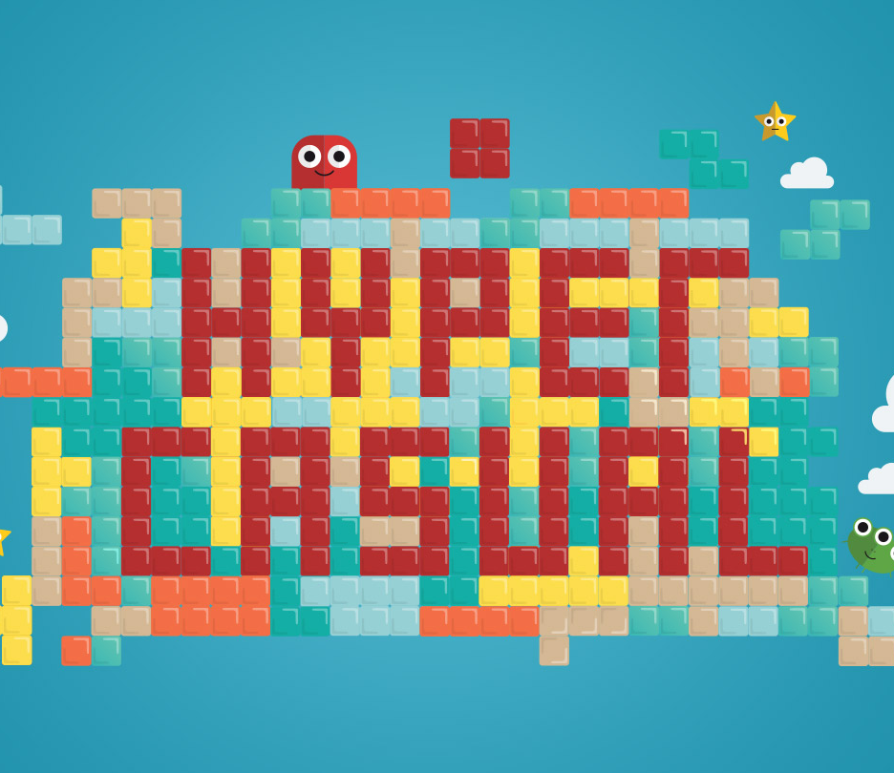
For this semester we agreed to release 2 Hyper-casual games for our graduation project.
We will be working with Happy Game Company and Rollic Games throughout these projects and our instructor informed us about their educational videos and guides so we will be using these materials to enhance both our knowledge and products.
Our first game is named “Cannon Smash” which is a 3D Hyper-Casual mobile destruction game where we shoot people from a cannon to destroy human towers and dancing giants.
Our second game is named “Fleptris” which is a 3D Hyper-Casual mobile runner game where we try to control a falling ball by hitting blocks of the same color as our character.

Slide 3
PROBLEM STATEMENT
The only problem in our case is the developing a game based on an idea.
Since it is not physical it can be difficult to develop due to it being an imaginational construct.

Slide 4

WHY IS THE PROJECT WORTH DOING
Although the Hyper-Casual games flooded the market with their low cost and high profit values it is still worth doing since the games that cannot manage to keep their content/ideas up to date they can bore their audiences easily because of this so the audience then seeks other products which is usually another hyper-casual game with a good and original idea behind it.

Slide 5
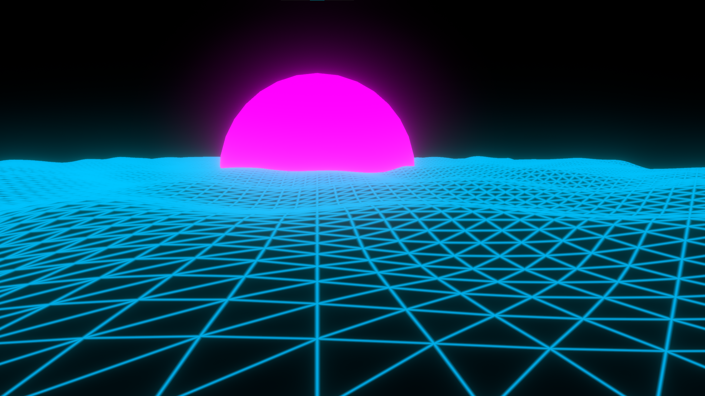
GRAPHICS

Slide 6
MODELLING & USER INTERFACE
Hyper-Casual games' monetization strategy with small ads depends on being played by large audiences. It is very difficult to appeal to all people of various races, genders, ages and cultures. That's why Hyper-Casual games are usually designed with easy-to-understand graphics and the rest is up to the user's imagination.
In order to continue this principle, we have designed the models and interfaces in our game in a way that is pleasing to the eye but not tiring.

Slide 7
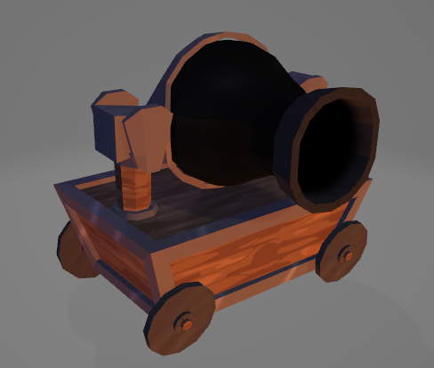
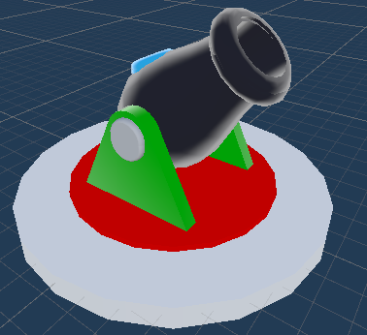
CANNON SMASH
In Hyper-Casual games, the lines are soft and the models are superficial, but this does not mean that they can be prepared randomly, on the contrary, it is difficult to do something simple differently.

Slide 8
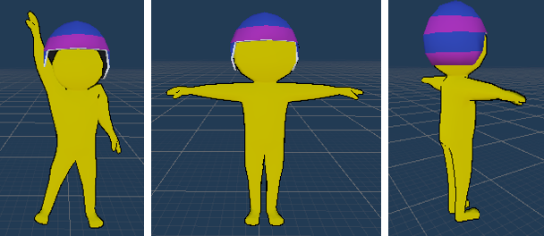
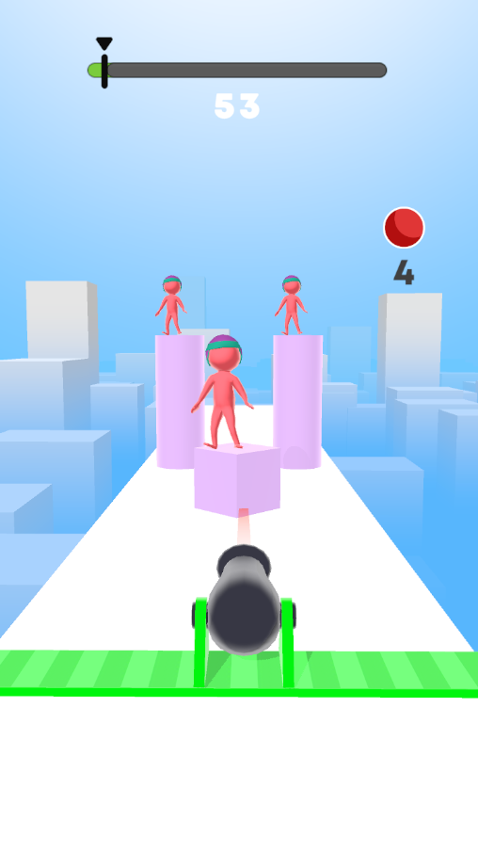
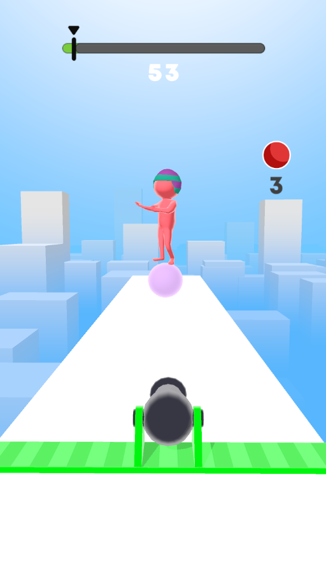
We decided to define 3 basic colors in the game, these are green, blue and pink tones.
We modeled our character the human cannonball helmet that many of us have seen in circus-themed movies.
We increased the traceability of our main character by using a non-theme color.

Slide 9
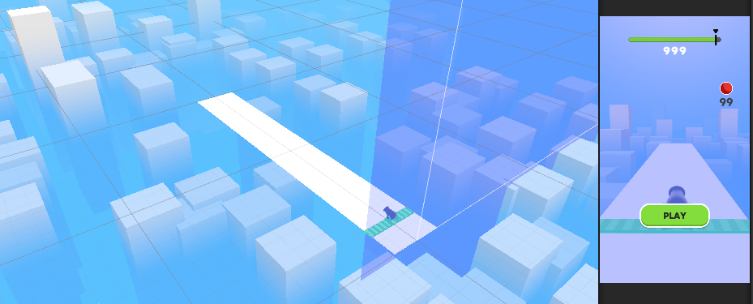
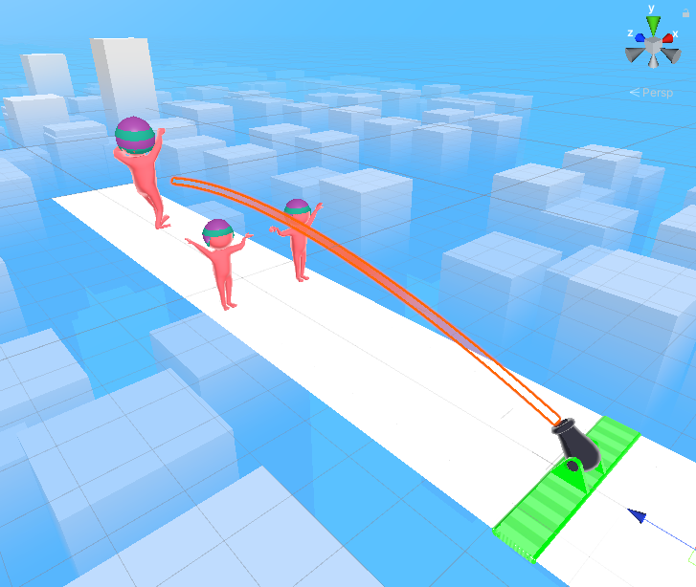
Coming to the environment of the game, we kept the ground very simple to avoid distractions, it was important for us to contrast with the characters and cannonball.
Outside of this surface, we have given the feeling of infinity with rectangular prisms accompanied by blue fog, so the user will not feel constrained.

Slide 10
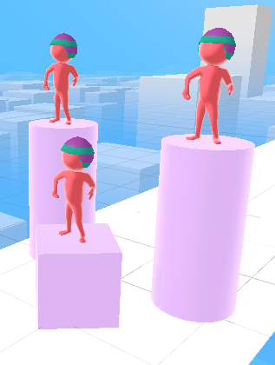
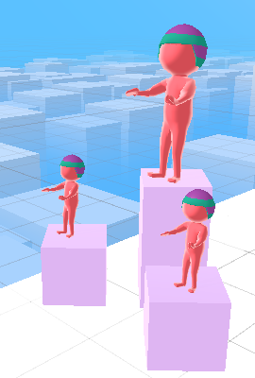
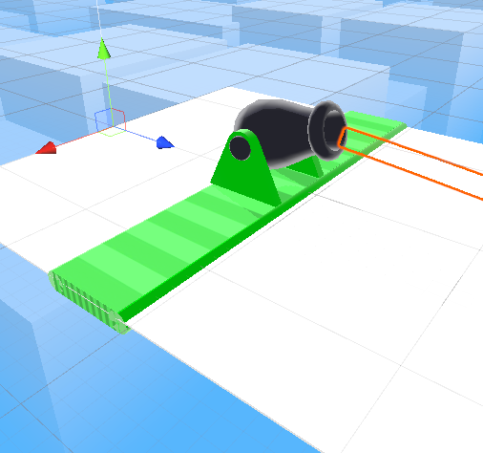
At the same time, to add variety to our sections, we added platforms of different sizes and shapes, as in the image below, and placed our characters on top of them, thus adding another dimension to the game on the Y-axis.
In addition to all that, we've added a theme-appropriate rail to the bottom of our cannonball to indicate its movement in the x-axis.

Slide 11
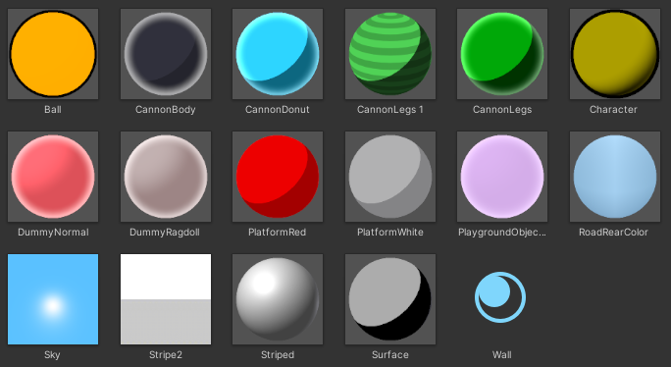
We carefully selected all the colors, shaders and materials in our game, we used MK Toon, Minimalist V2 and Epic Toon FX to reflect the Hyper-Casual look in the best possible way.

Slide 12
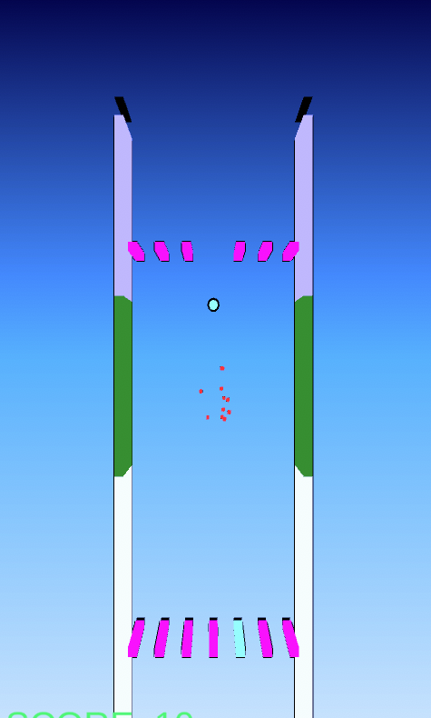
Fleptris
In "Fleptris" we tried to keep the models as simple as possible, one of the things we wanted to try in this game was to see what someone who is far from modeling can do with just code skills and unity's interface.

Slide 13
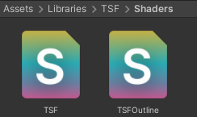
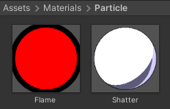
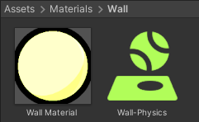

With the custom shaders, special particle effects and post processing methods we used, we aimed to provide an eye-catching Hyper-Casual experience from just simple cubes and spheres.

Slide 14
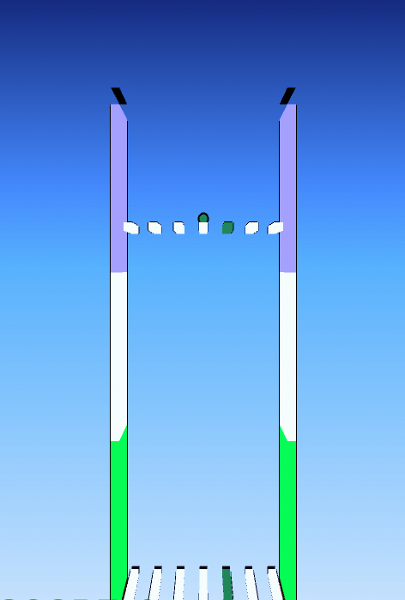
In "Fleptris", we placed dashed lines on the right and left walls to show our speed, and these colors change with the game, so we provide both a dynamic image and color transitions for the active that does not bore the user.

Slide 15
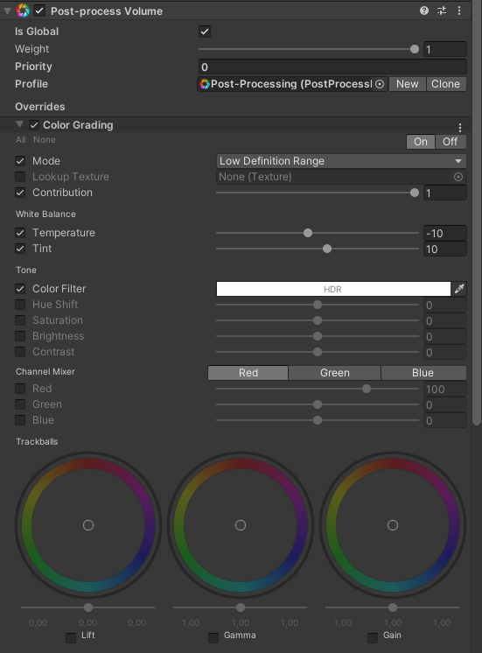

We used custom shaders and the post processing method to control the colors of the ball and the edges.

Slide 16
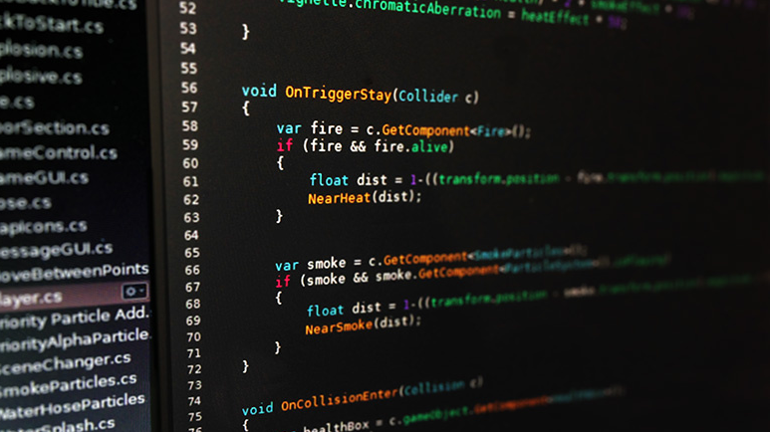
DEVELOPMENT

Slide 17
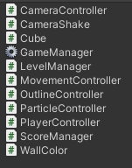
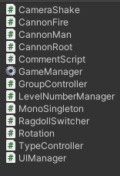
For Scripting in our Games we have used C# as a programming language and Visual Studio 2019 as the IDE.
We wrote 26 C# scripts and 1921 lines of code to make these two games happen.
You can examine the purpose of each code one by one in our document.
Unless otherwise stated, all codes and images in the document belong to us.

Slide 18

We used many game development plugins and assets in our project.
MK Toon
Epic Toon FX
Cartoon FX
Minimalist V2
Super Confetti FX
TextMesh Pro
Imphenzia GradientSky
Toon Shader
Text Mesh PRO
Naughty Attributes
We also used animations from Adobe-Mixamo
&
Input Manager from Happy Game Company

Slide 19
RESULTS

Slide 20
CONCLUSION

